Slide 1

BANK CHURN ANALYSIS
EXCEL ANALYSIS

Slide 2
the average credit score for each geography?
Solution Insight:
This simple average calculation shows that, across the three countries, customers in Spain generally have slightly higher creditworthiness compared to customers in France and, notably, Germany.
Row Labels | Average of CreditScore
France | 592.55
Germany | 579.69
Spain | 600.99
Grand Total | 591.416

Slide 3
How does the average account balance vary between genders within each country?
Solution Insight:
In Germany, females have a substantially higher average account balance than males (over 12,000 difference).
In France, males have a slightly higher average balance.
In Spain, females also have a slightly higher average balance.
Average of Balance | Column Labels
Row Labels | Female | Male | Grand Total
France | 129577.0 | 133204.8 | 131168.1
Germany | 140888.3 | 128591.0 | 134152.2
Spain | 120986.2 | 118082.1 | 119618.6
Grand Total | 129659.7 | 126503.5 | 128132.1

Slide 4
Title
The distribution of active members versus non-active members according to having credit card
There appears to be a positive association between being an Active customer and owning a credit card. Active customers are slightly more credit-card-carrying than non-active customers.
Count of Has Cr Card | Column Labels
Row Labels | 0 | 1 | Grand Total
Non Active | 140 | 123 | 263
Active | 113 | 124 | 237
Grand Total | 253 | 247 | 500

Slide 5
the customer churn rate per number of products used
INSIGHTS:
Product2 is the Biggest Contributor to Churn: With 74 churned customers, Product2 accounts for the largest share of the overall churn (27.2%), making it the top priority for investigation.
Product4 has the Lowest Churn Count: Product4 has the lowest absolute number of churned customers at 64 (23.5%).
Churn is Relatively Evenly Distributed: The difference between the highest-churning product (Product2 at 74) and the lowest-churning product (Product4 at 64) is only 10 customers, meaning that all four products contribute a similar amount to the total churn volume.
Row Labels | Sum of Churn
Product1 | 69
Product2 | 74
Product3 | 65
Product4 | 64
Grand Total | 272

Slide 6
the average credit score for customers who have exited compared to those who have stayed, across different tenure
Solution Insight: This comparison reveals that customers with a lower average credit score are slightly more likely to exit the bank (churn). The data provided appears to be grouped only by Churn Status (0/1) and not explicitly by Tenure, despite the question.
Row Labels | Average of CreditScore
Non Active | 599.0
Active | 583.0
Grand Total | 591.416

Slide 7
YOUR TITLE GOES HERE 7
1 | How many missing values are in the "EstimatedSalary" variable?
Answer | 3
2 | What is the average balance excluding the inconsistent value?
Answer | 128132.088
3 | What is the average credit score of the customers from Germany?
Answer | 579.69
4 | What is the average bank balance of the male customers from France?
Answer | 133204.76
5 | How many of the customers got churned among the customers who have a credit card?
Answer | 131
6 | How many of the customers stayed among the customers who have used 3 products?
Answer | 53
7 | What is the average credit score for a churned customer who have a tenure of 1 year?
Answer | 616.833
8 | What is the average salary of churned customers?
Answer | 83428.09
9 | What is the conclusion for the research question 1?
Answer | The Average credit score in france and germany is slightly less than spain so special offers on credit card shold be given to encourage customers to use credit cards like bonus vouchers
10 | What is the conclusion for the research question 2?
Answer | The Highest Average Balance is Held by German Females
 | Customers in Germany hold the highest average balances overall.
 | Within Germany, Female customers have a substantially higher average account balance (140,888.3) than Male customers (approx128,591), representing a difference of over 12,000. This group should be a focus for retention strategies.
 | Balance is More Gender-Equal in France and Spain
 | In France, Male customers hold a slightly higher average balance (approx133,205) than Female customers (approx129,577).
 | In Spain, Female customers also hold a slightly higher average balance (approx120,986) than Male customers (approx118,082).
 | The difference between genders in France and Spain is minimal compared to the large difference seen in Germany.
 | Spanish Customers Hold the Lowest Balances
 | Customers in Spain have the lowest average account balance for both genders compared to France and Germany.

Slide 8
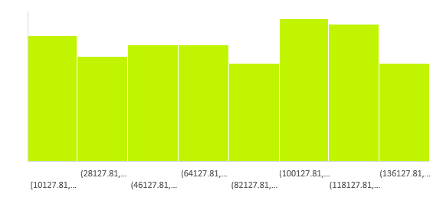
significant difference in customers' average earning between churned and not-churned
t-Test: Two-Sample Assuming Unequal Variances
 | non-churn | churn
Mean | 80464.52 | 83428.09
Variance | 1639699948.54 | 1718690175.50
Observations | 228.00 | 272.00
Hypothesized Mean Difference | 0.00
df | 487.00
t Stat | -0.81
P(T<=t) one-tail | 0.21
t Critical one-tail | 1.65
P(T<=t) two-tail | 0.42
t Critical two-tail | 1.96
INSIGHTS:
There is no statistically significant difference between the means of the 'non-churn' and 'churn' groups for the variable being measured.
While the 'churn' group's mean is numerically higher (83428.09 vs. 80464.52), this observed difference is small enough that it could easily be due to random chance or sampling variability.
WE cannot confidently conclude that the underlying populations have different means for this variable based on this data.

Slide 9
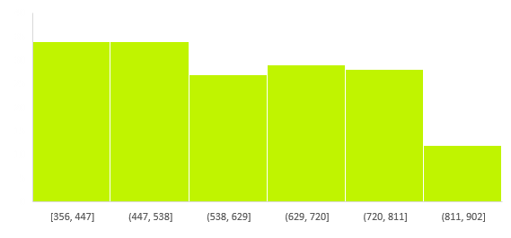
significant difference in customers' average credit scores among customers' geographic location
INSIGHTS:
Based on this analysis, you would conclude that the average performance/measurement/value is the same across France, Germany, and Spain. The small differences you see in the "Average" row are not statistically meaningful.
SUMMARY
Groups | Count | Sum | Average | Variance
France | 166 | 98245 | 591.8373 | 19857.60369
Germany | 157 | 91012 | 579.6943 | 18409.21362
Spain | 169 | 101087 | 598.1479 | 18824.17442
Source of Variation | SS | df | MS | F | P-value | F crit
Between Groups | 28446.44 | 2 | 14223.22 | 0.746998335 | 0.474326424 | 3.014160039
Within Groups | 9310803 | 489 | 19040.5
Total | 9339250 | 491

Slide 10
THANK YOU
PREPARED BY MANISH TOMAR

